Slide 1

Notes:
If you have ever set foot into a GameStop, you are probably well aware of Game Informer.
With total circulation of ~7m and 300 issues over almost 30 years, their influence is apparent.

Slide 2
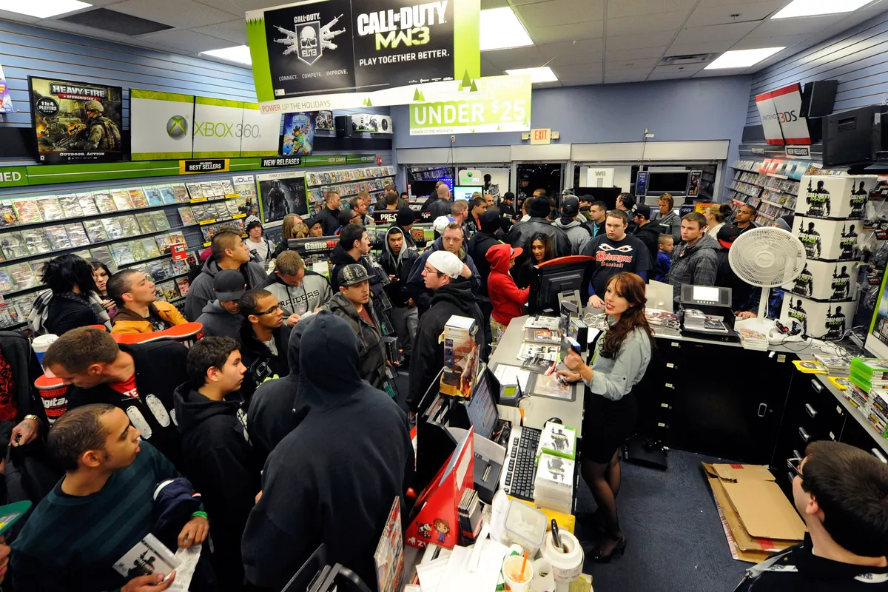
Notes:
There is a somewhat subtle issue at hand… the retailer and the periodical are one and the same.

Slide 3


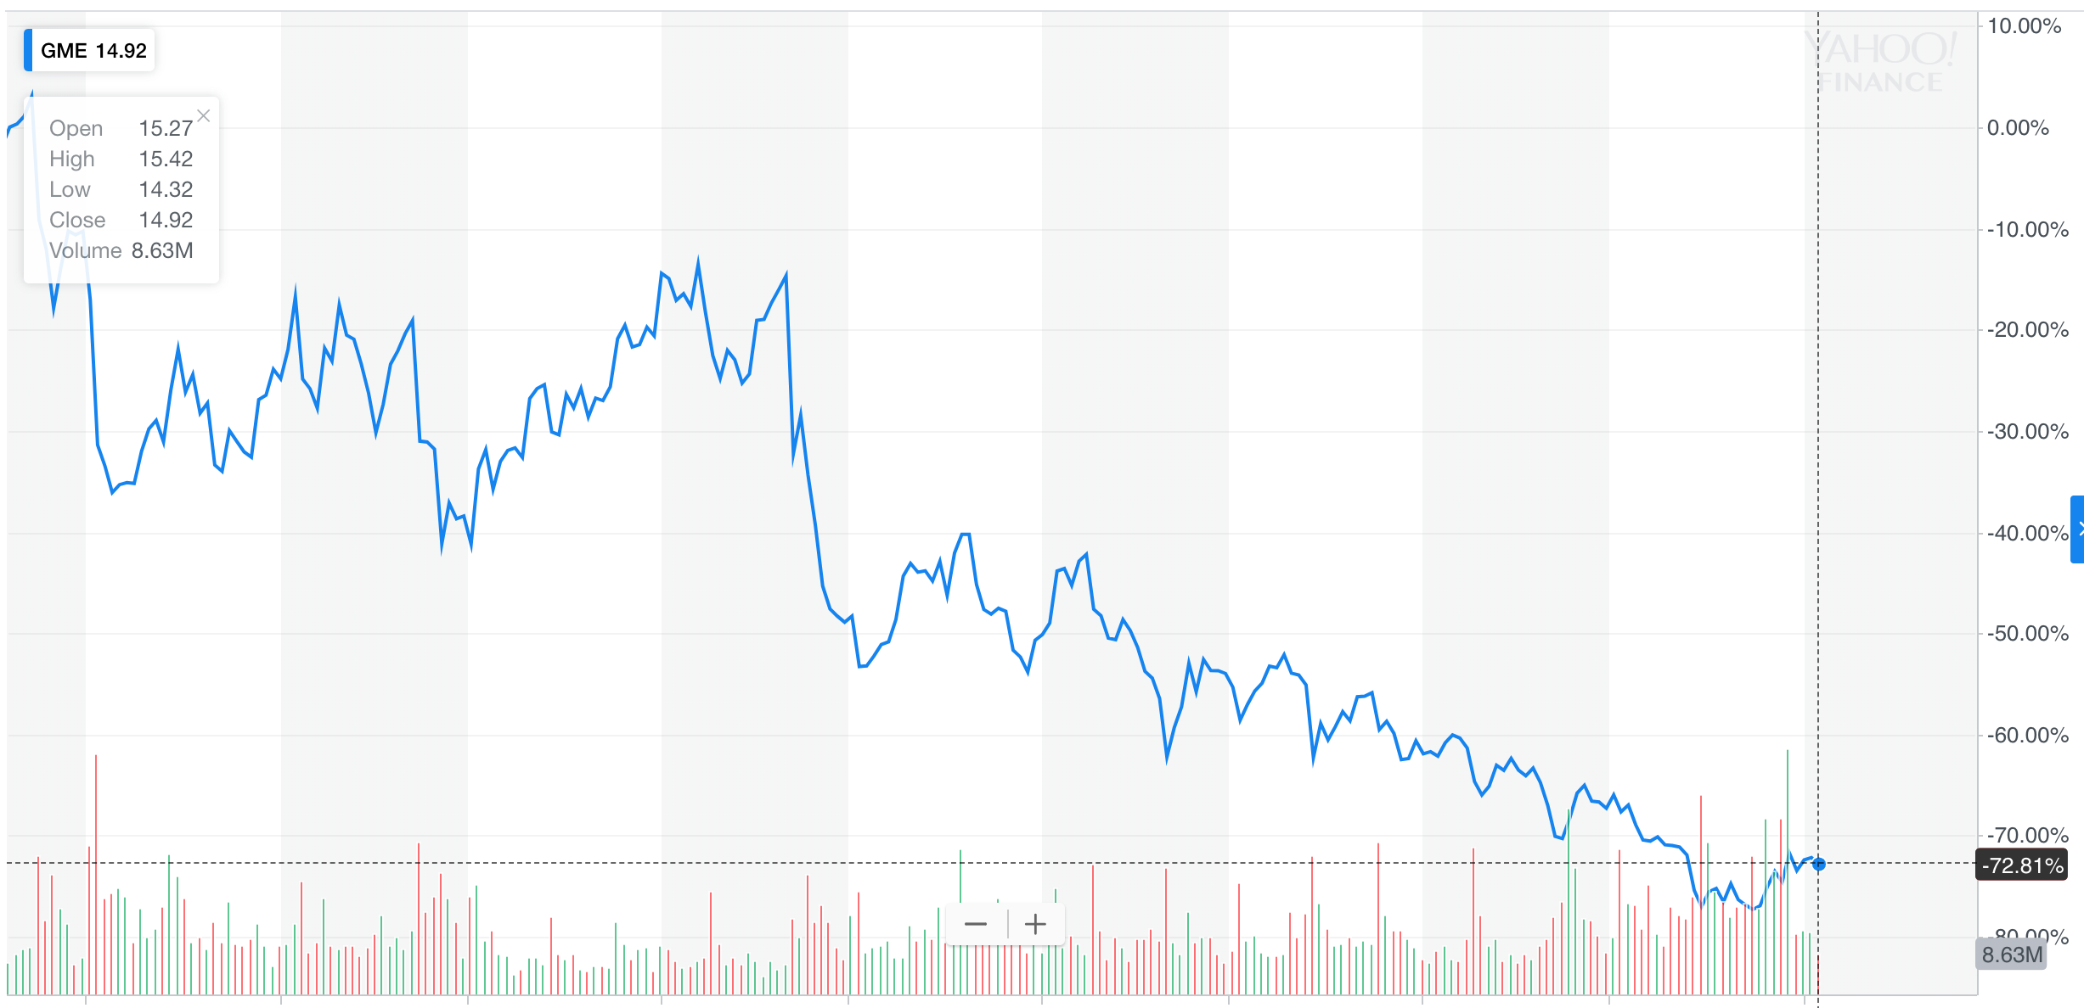
Notes:
And unfortunately, GameStop desperately needs to sell games…
Is this where you should be getting your game info?

Slide 4
Data Mining
Data Wrangling
Exploration
GameInformer reviews, game data, & stock performance
Clean
Modeling
Base-line
Pair-wise features
Selenium, BeautifulSoup
Calculate
Consolidate
Data distribution
Correlations
Base-line model
Fine-tune
Train-test-split
Model Evaluation
Conclusion
Analysis of results
Applications
Further study
Process & Outline

Slide 5
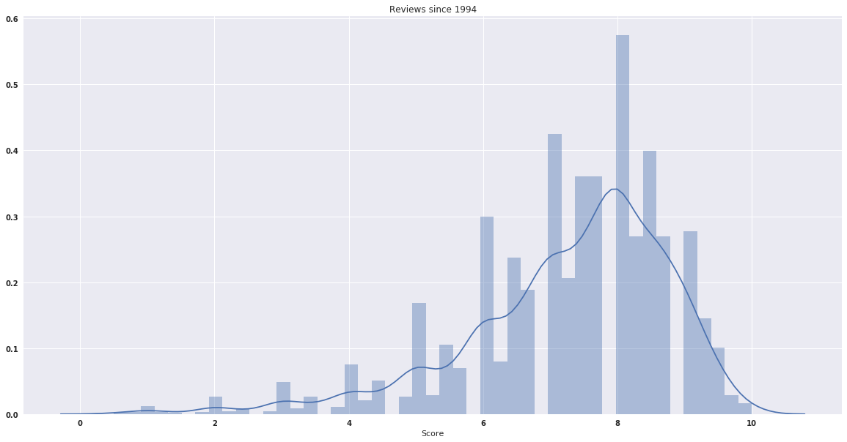
Game Informer Reviews since 1994
8
Notes:
Data is clustered around 8 and skewed highly to the left.
The KDE line suggest all games are likely to be highly rated. Are all games that good?

Slide 6
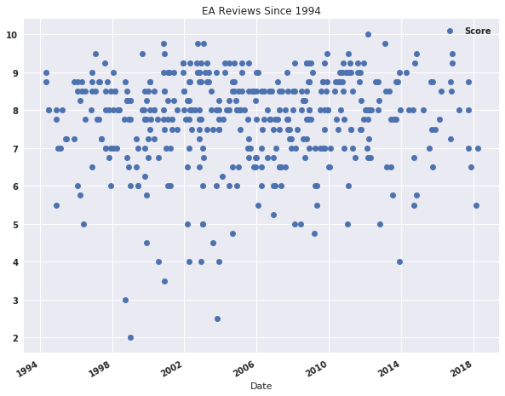
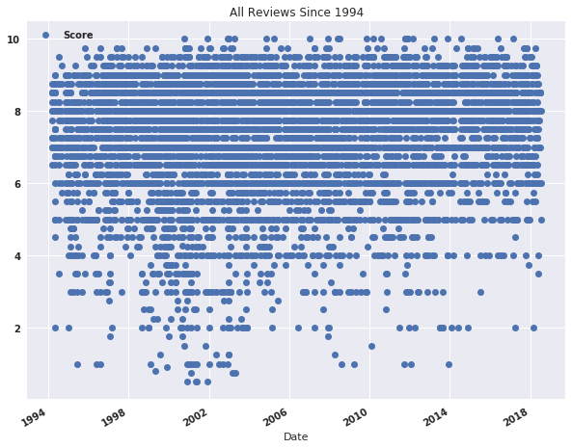
Notes:
Is GameInformer honest? or just advertising?
Skew consisten over 25yrs…this gives us reason to be suspicious.
EA is no exception.

Slide 7
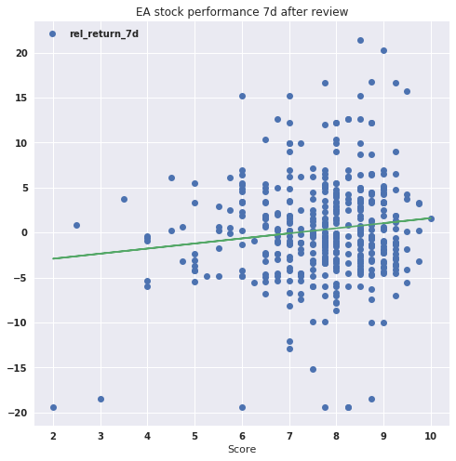
EA Stock Return vs. Review Score
Notes:
EA stock seems to perform well the week after review
Scores below 6 tend to show negative reviews
but the skew is still apparent at the higher end, inline with outlier performers

Slide 8
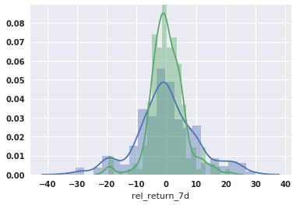
Distribution of Returns
Notes:
In contrast, distribution of target variables (returns) appears very normal.

Slide 9
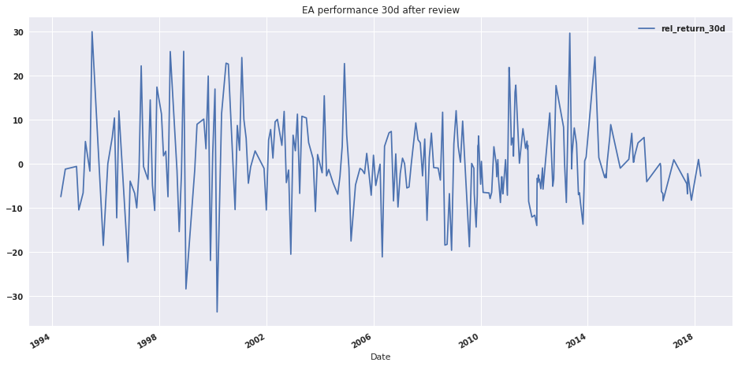
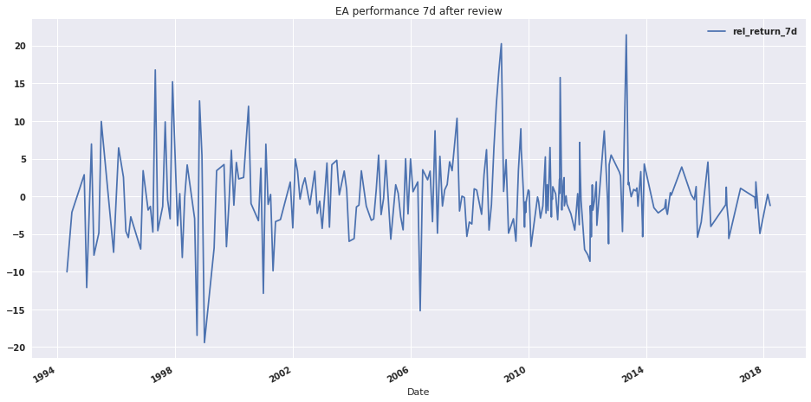
EA Stock Returns After Reviews
Notes:
Recent years indicate tighter returns around weekly reviews
This holds for a wider return period as well

Slide 10
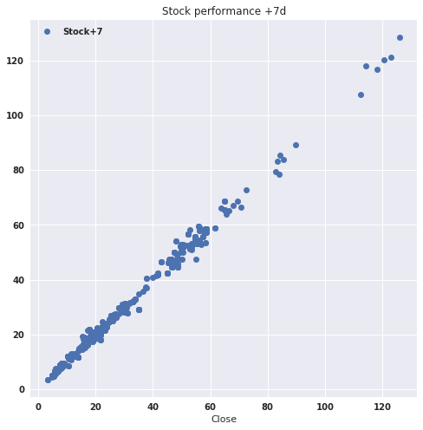
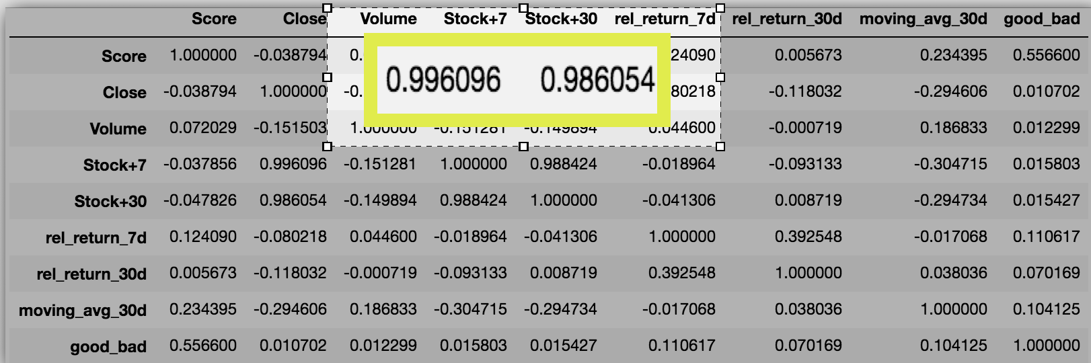
Closing Px vs. Future Performance
Notes:
But today's stock price is an essential input for the forward price.
As our correlations confirm
This will become a critical component and difficulty as closing price is a necessary input

Slide 11
Modeling: Capturing the “Alpha”
Baseline Linear
(R²=0.992, 0.972)
Model Selection
Polynomial
R²=0.976
Hold 0.954
Linear
R²= 0.970,
Hold 0.952
Plus Features
(R²⁼0.970, 0.952)
Score: coeff. -.15, p-val. 0.275
Non-linear
Effect
Closing Prices & Future Returns
Scores
Moving Avg.
Volume
Prices
How’s our model?
Notes:
Baseline = perfect fit
feature selection no effect.
What effect these reviews have??? maybe small and non-linear
Train-test-10%split = 0.970 leaves room to improve

Slide 12
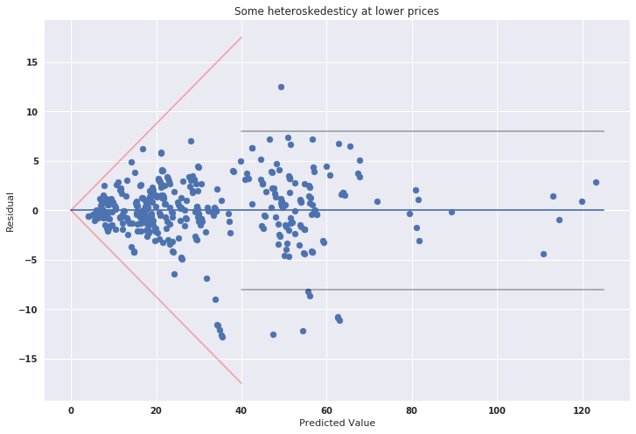
Evaluating the Model
2014
Notes:
#Some heteroskedasticity at lower range of closing prices
#The model improves at higher range
#recall…

Slide 13
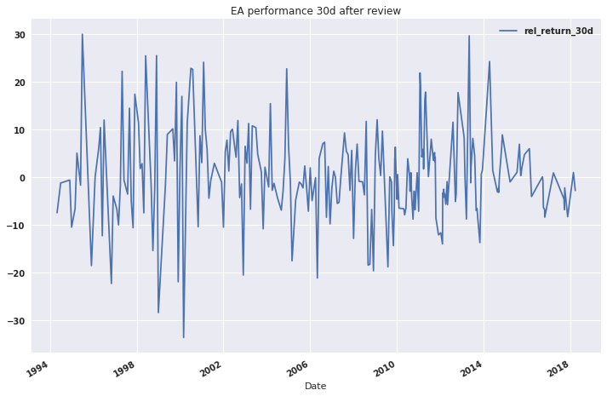
Notes:
….the residuals become tighter as the stock volatility decreases.
The model works better in lower vol markets. (less noise)

Slide 14

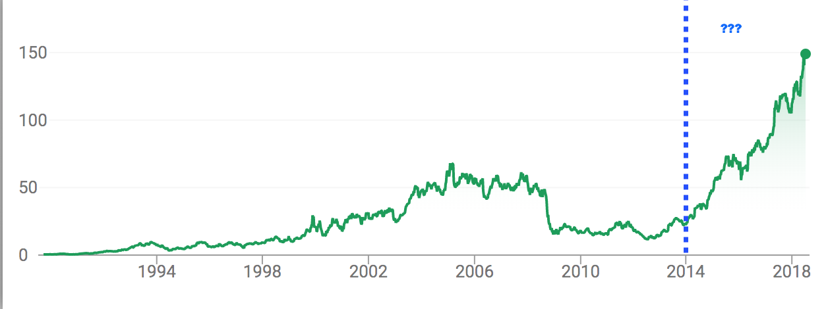
What changed in 2014?
Notes:
Stock is up nearly 500% since 2013….what happened?
Andrew Wilson happened Sep’2013….
His leadership led to increased profitability and reduced stock volatility
Combined with the already skewed reviews, this is in-line the model

Slide 15
Effect appears small at first…
Scores <5 vs. scores > 9
-3% 7d vs. +1%
-5% 30d vs. -2%
Scores > 9
Why -2% long term?
1/3 during recessions (-5%)
Scores < 5
They are pre-2004, -20% on avg:
Fifa ’00 4.5
World Cup ’98 3
Tiger Woods Golf ’99 2
SSX Tricky 4

Slide 16
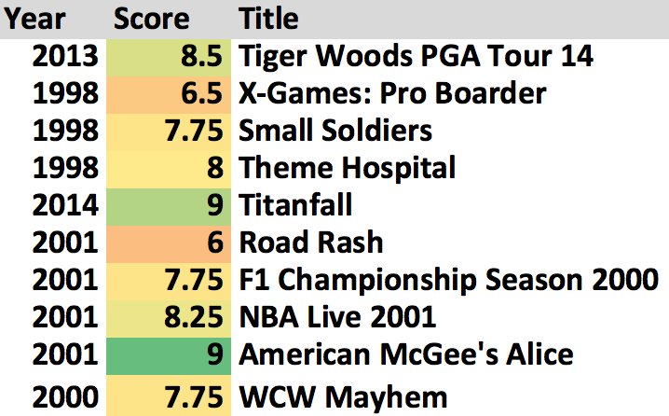
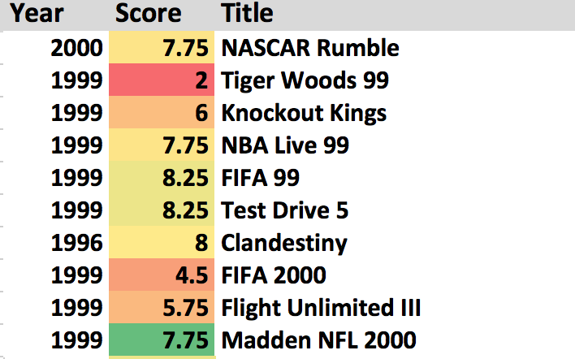
Top vs Worst Performers
Top 5% vs. Lower 5%
+15% 7d -12.5%
+20% 30d -25%
7.8 score 7.3

Slide 17
Next Steps….
Notes:
Ubisoft, THQ, Take-Two, ATVI
Consolidate more reviews to have feel for overall landscape
Try to isolate Year as a variable; removing or enhancing returns in recessions/market decline
See if certain authors have more influence
Isolate more factors specific to EA
See if there is correlation with physical game sales vs review ratings & qty
Try to extrapolate to earnings not just stock performance

